Slide 1


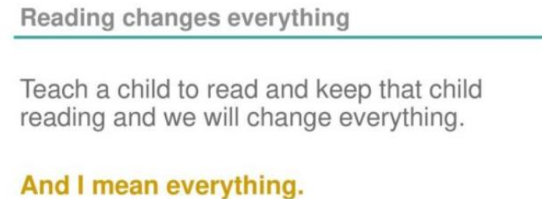
Early Years Reading
09.01.25

Slide 2
What is Sounds Write?
Sounds-Write is an evidence-based highly structured, synthetic, linguistic phonics program.
It is taught daily in EYFS, Year 1 and Year 2.
In KS2 the child who need to continue with their phonics will receive intervention ‘boosters’.
Children will learn to recognise and read sounds before they write them.

Slide 3
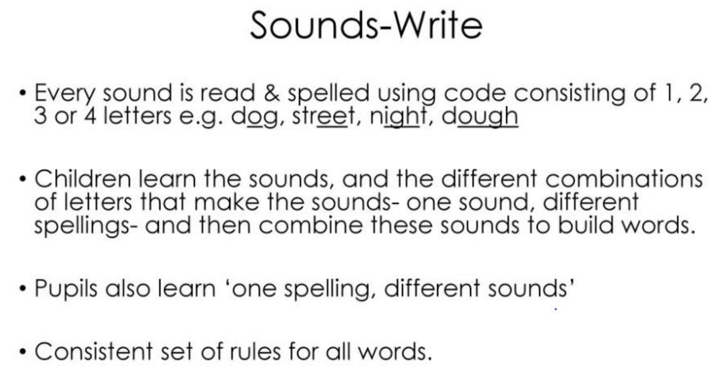

Slide 4
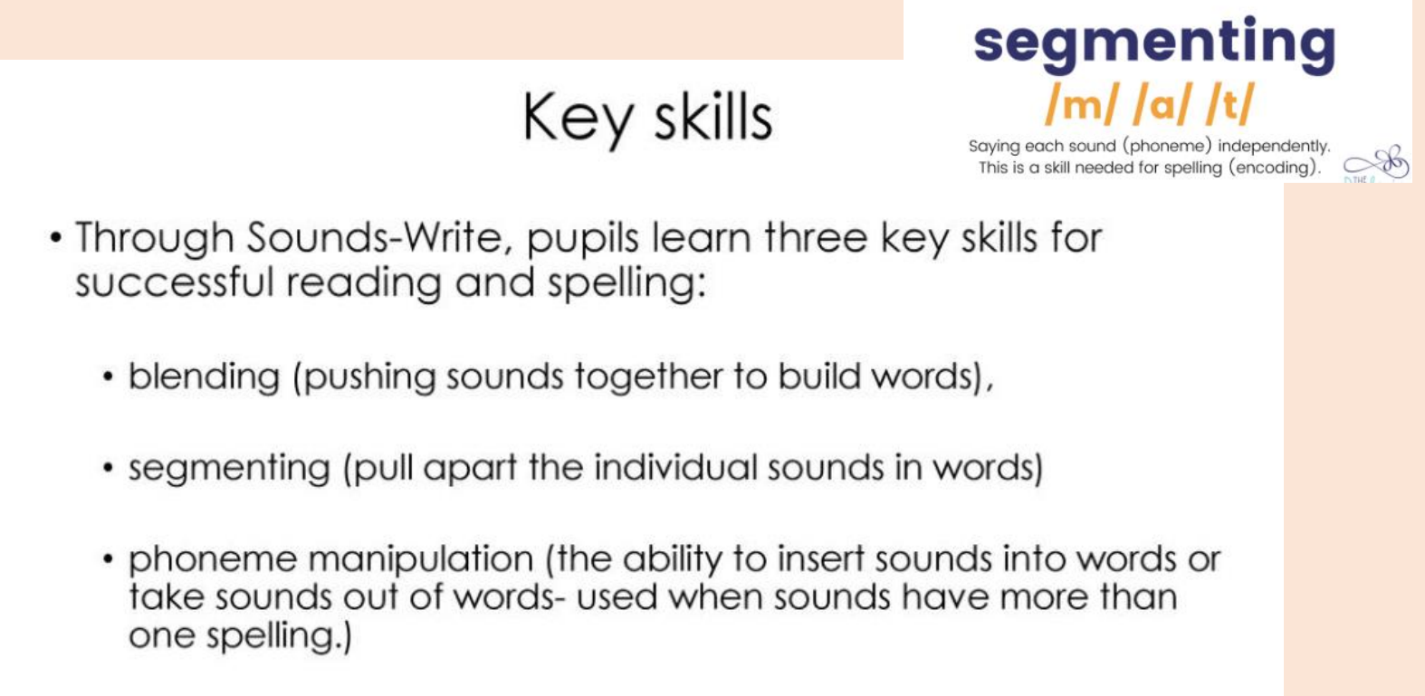

Slide 5
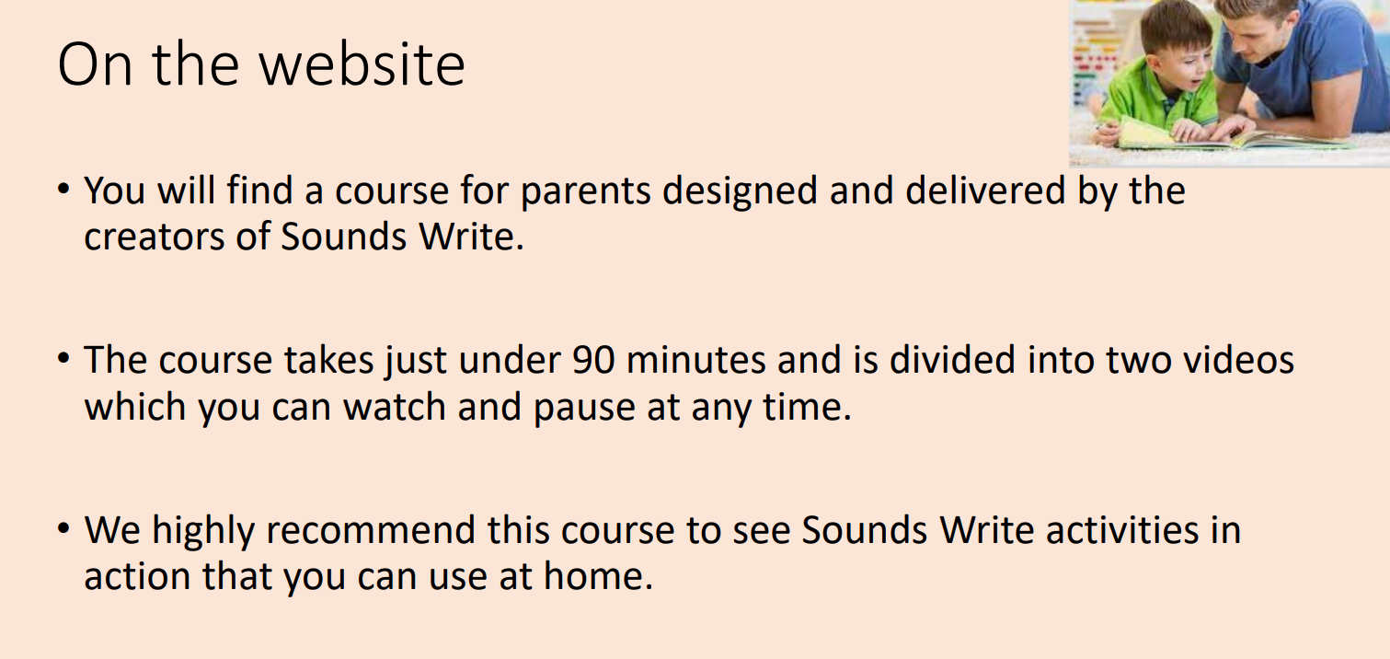

Slide 6
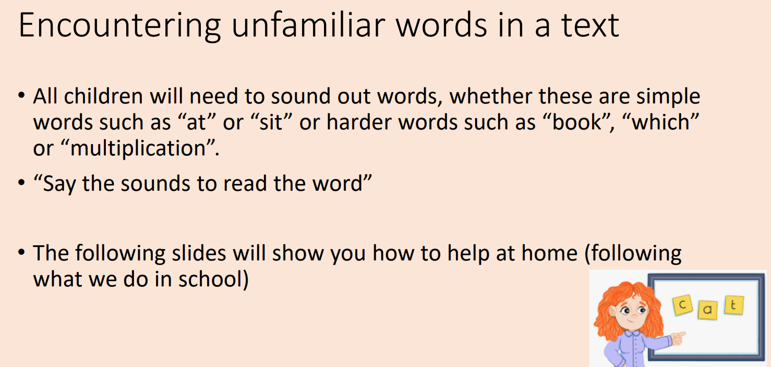

Slide 7
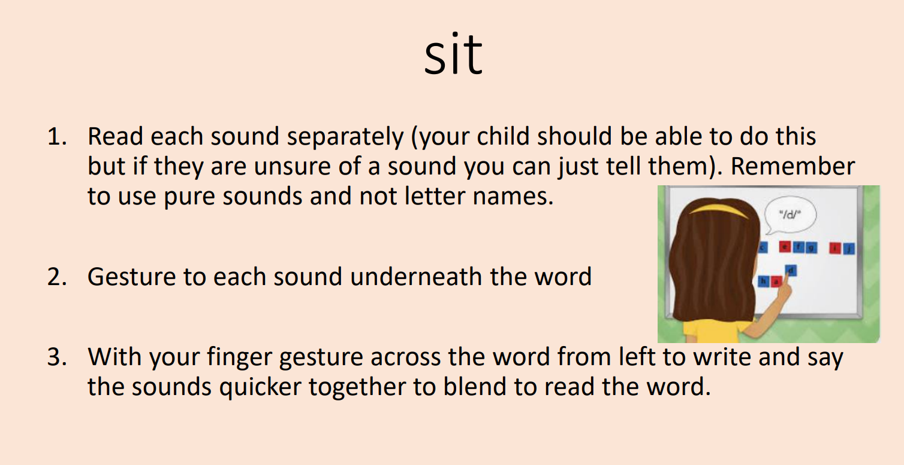

Slide 8
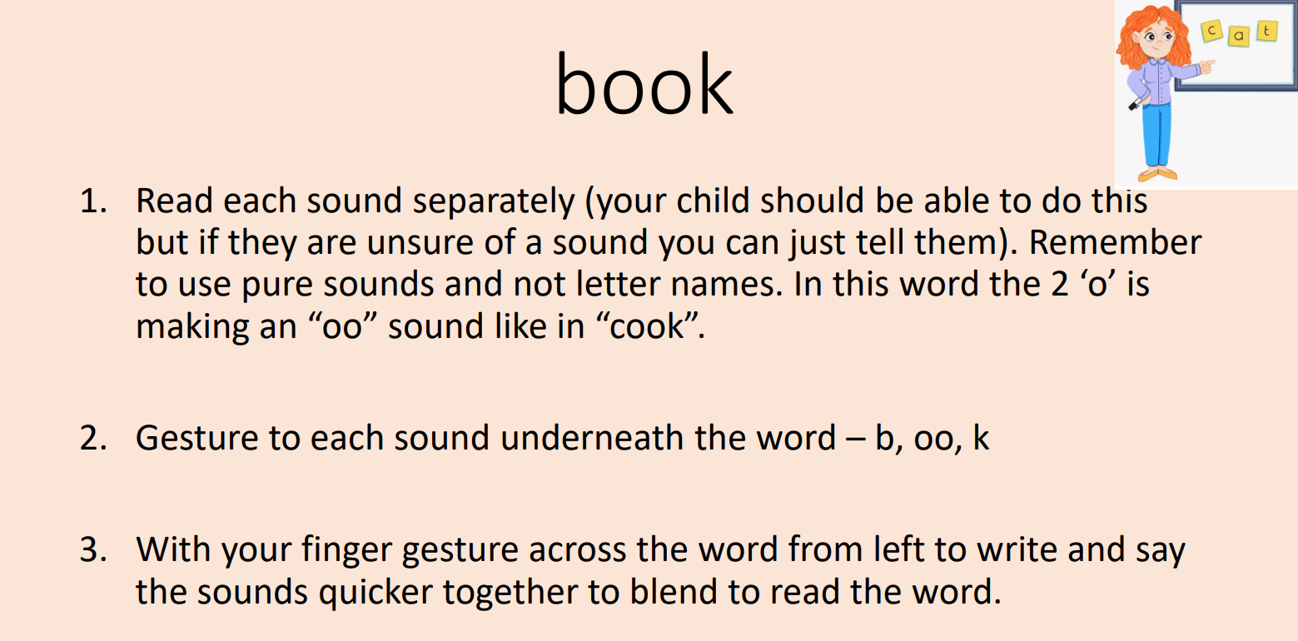

Slide 9
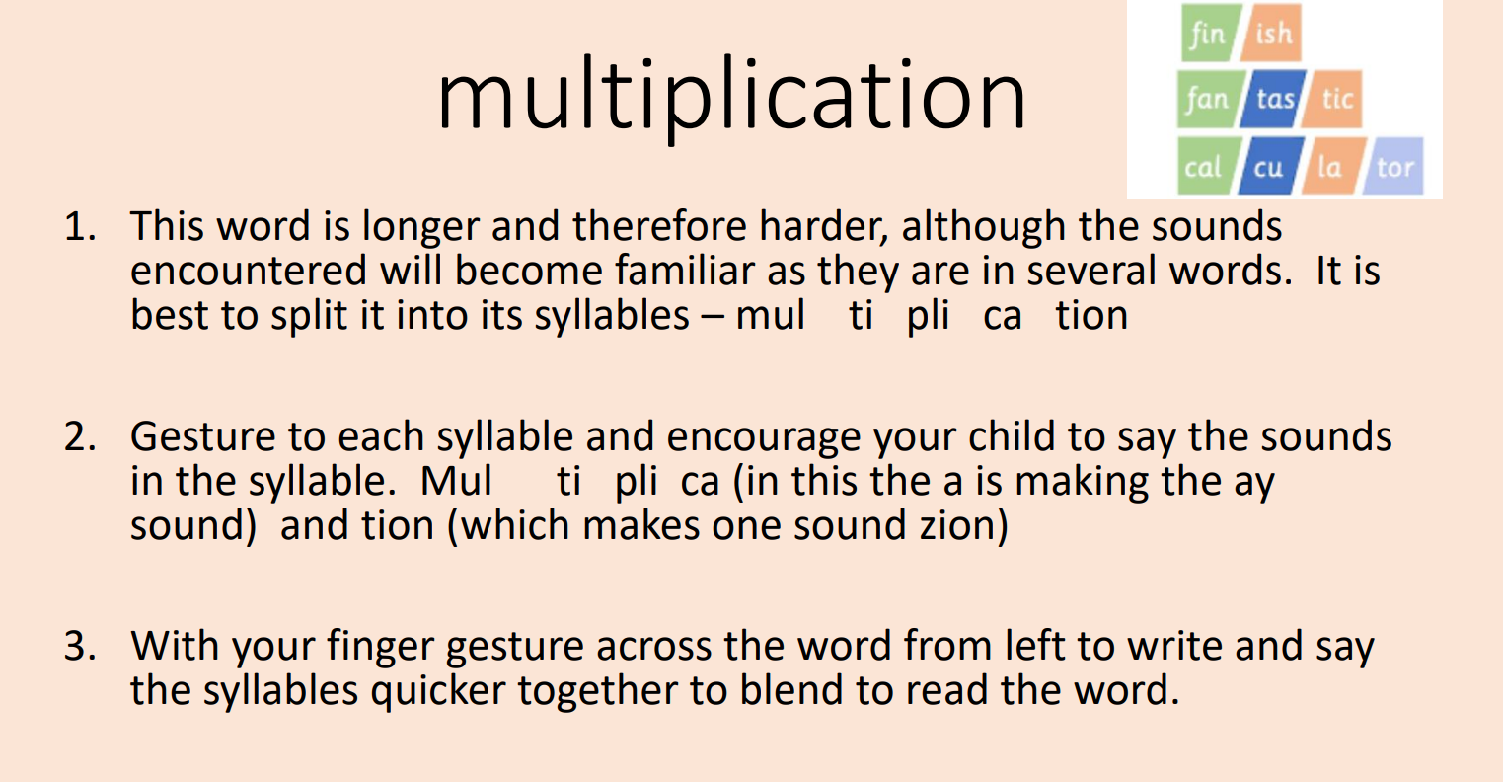

Slide 10
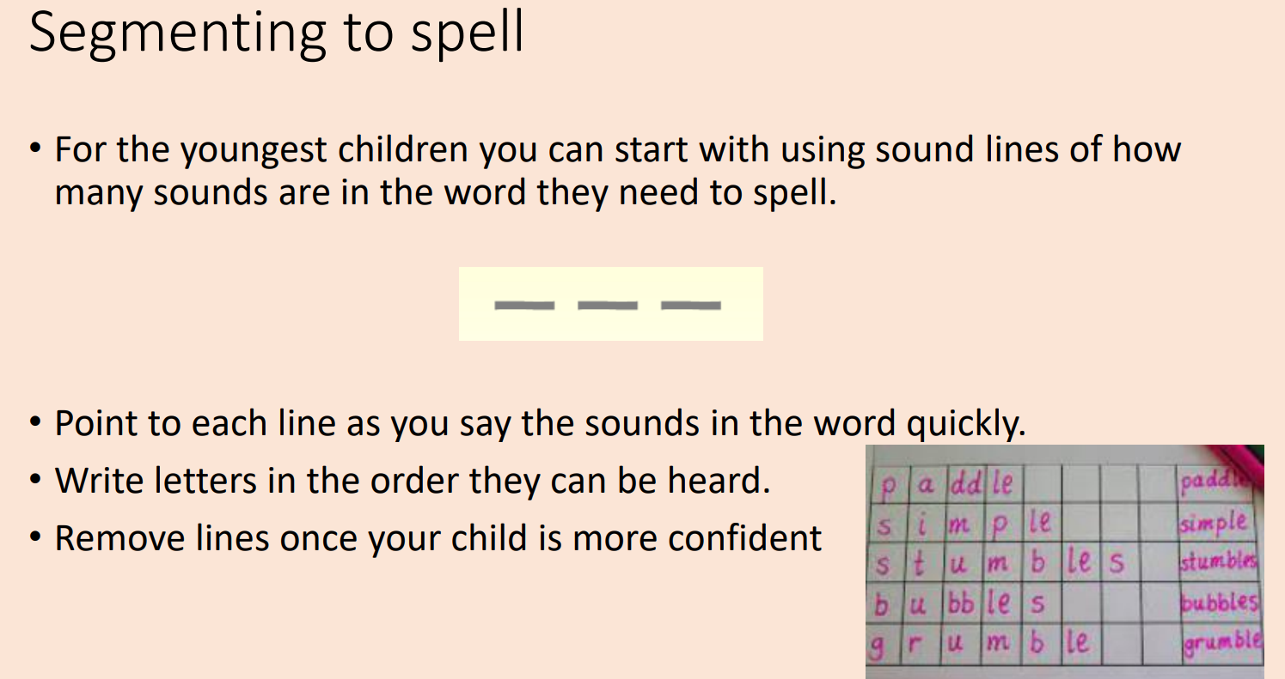

Slide 11
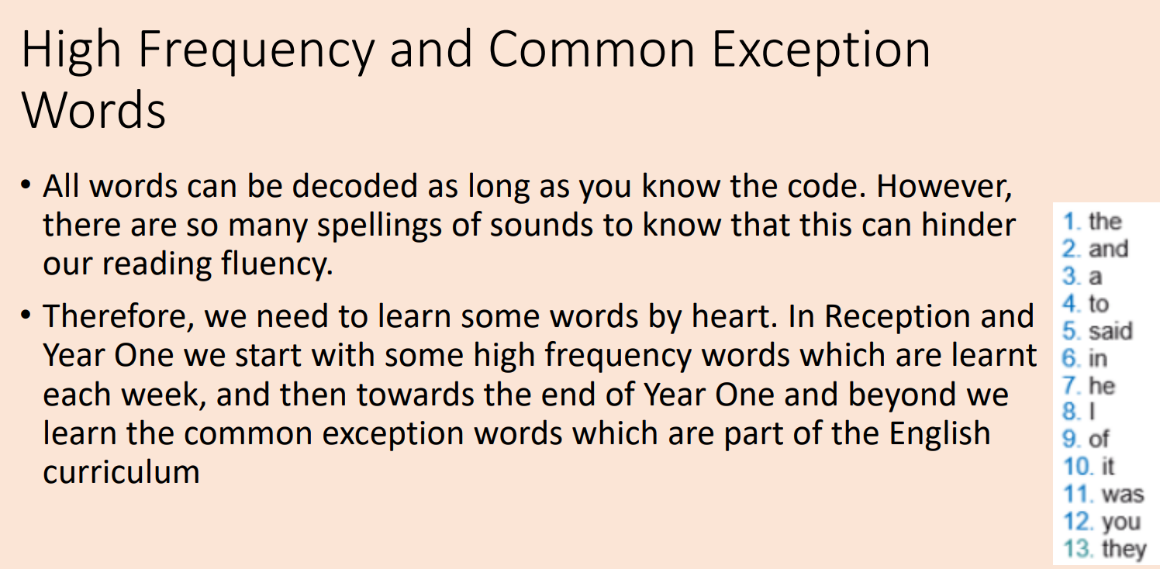

Slide 12
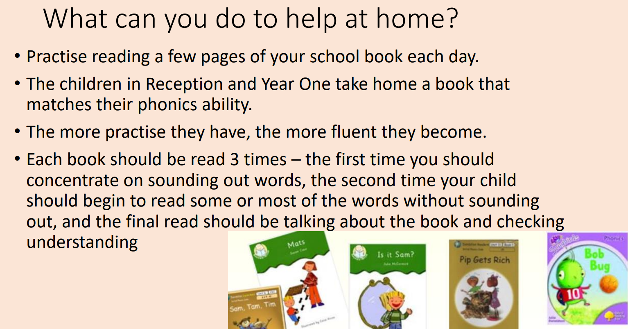

Slide 13
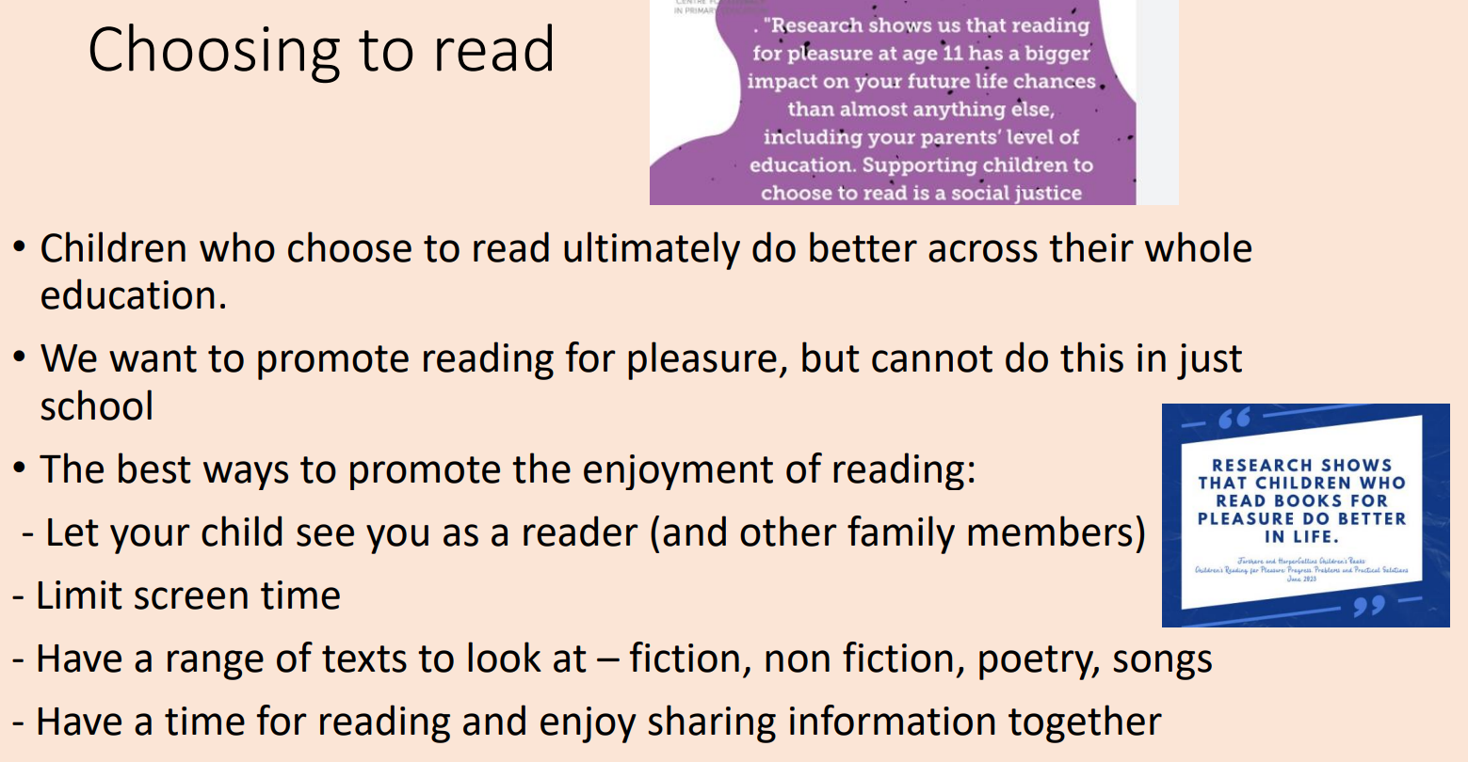

Slide 14
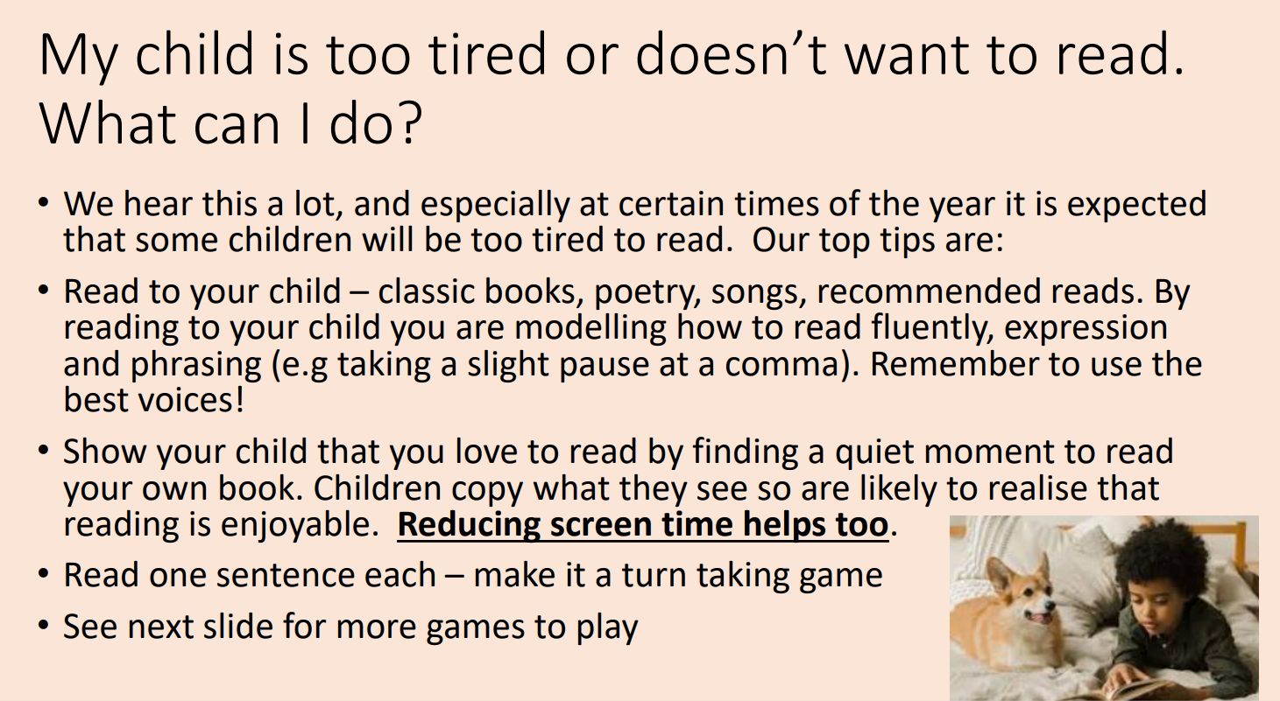

Slide 15
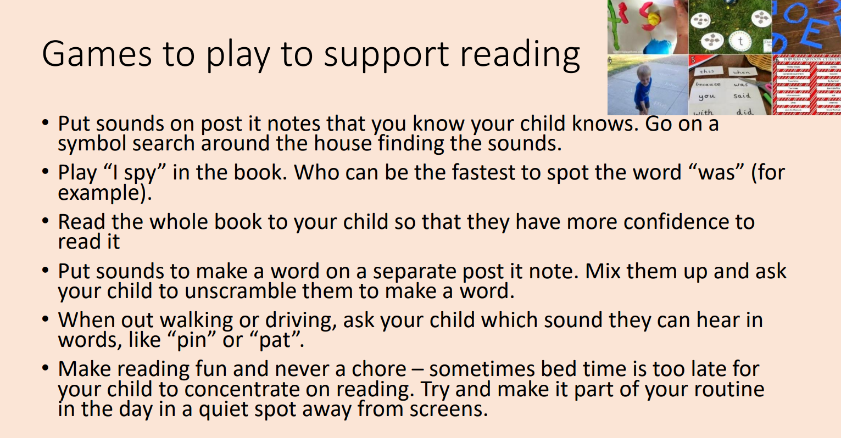

Slide 16
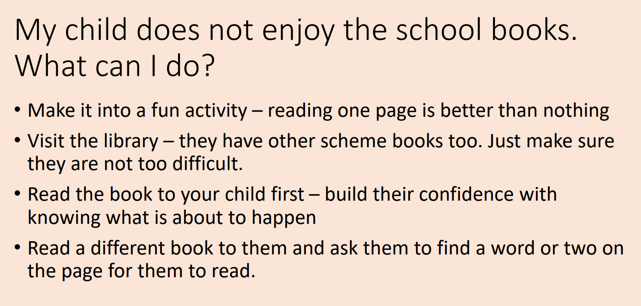

Slide 17


